Slide 1
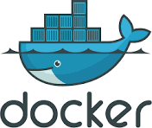
Introduction to Docker
Containerization Made Easy

Slide 2
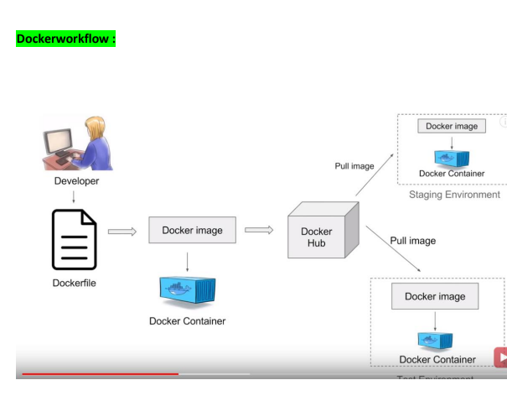
Docker
Definition: Docker is a containerization tool that allows for virtualization.
Docker work flow diagram:
⦁ Developer creates a Docker file.
⦁ The Docker file is turned into a Docker image.
⦁ The Docker image is upload to docker hub.
⦁ Staging Environment pulls the Docker image.
⦁ A Docker Container is created from the image.

Slide 3
Docker Contains Client-Server architecture:
Its architecture consists of mainly 3 parts:
1.Client: Client can create, build ,run and even stop the application.
Client can also interact to Docker-Host remotely.
2.Docker-Host:
It contains containers, images and docker daemon.
It provides complete environment to execute and run your application.
3.Docker Registry/hub:
It is a global repository of Docker image.
You can access and use these images to run your application in docker environment.

Slide 4
Basic Docker commands
docker --version: Displays Docker version.
ifconfig -a: Shows network configuration.
docker info: Displays complete information about Docker.
docker images: Lists all Docker images.
docker ps: Shows running containers.
docker ps -a: Shows all containers.
docker pull : Pulls image from the official repository.
docker inspect : Displays pulled image details.
docker run -it --name : Creates and runs a container.
Example: docker run -it --name tomcat -p 40:80
if we delete the docker container then there will be backup bcoz we can create multiple docker containers from the docker image.

Slide 5
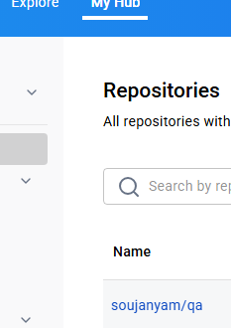
Commands to Install Docker:
⦁ Go to google and search Docker hub then we get--https://hub.docker.com/
⦁ login and create new repository-name qa.
⦁ Go to the AWS Management Console.
⦁ Launch a new EC2 instance: docker
yum install -y docker
docker --version
ifconfig -a
service docker start
docker info
cd /var/lib/docker

Slide 6
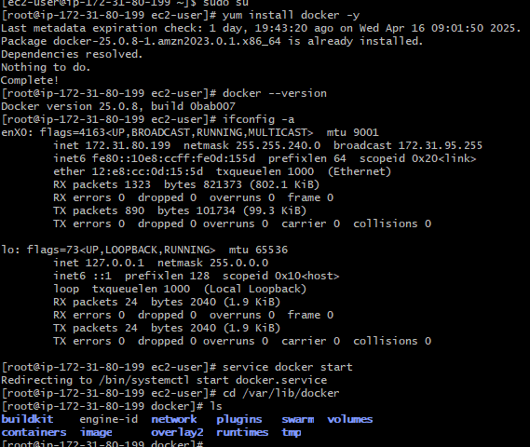
Commands to Install Docker:
yum install -y docker
docker --version
ifconfig -a
service docker start
docker info
cd /var/lib/docker
docker images
docker ps
docker ps –a
docker pull nginx
docker inspect imageID
docker run -itd --name ngnix -p 40:80 4cad75abc83d
docker tag nginx:latest soujanyam/qa:ngnix
docker push soujanyam/qa:ngnix

Slide 7
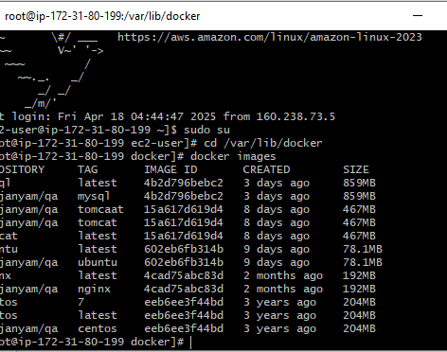
Pull images

Slide 8
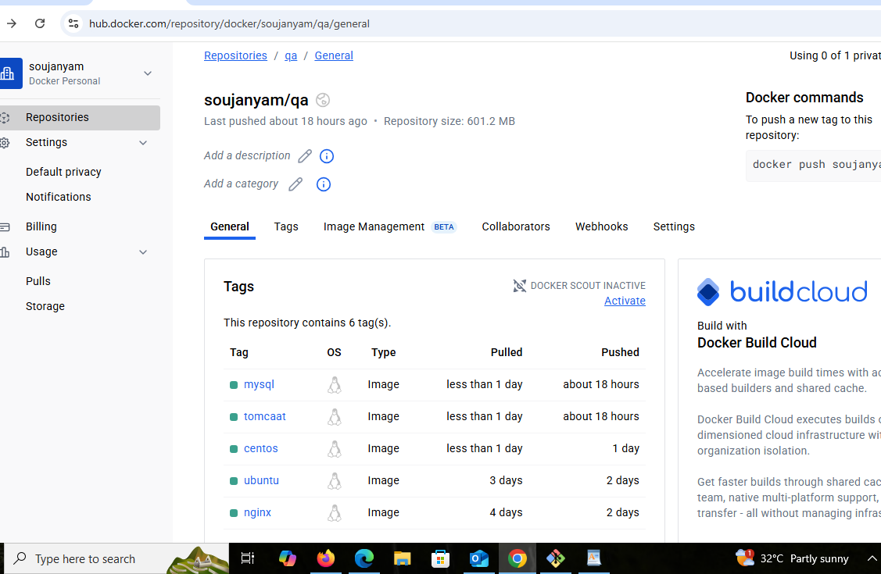
Docker hub

Slide 9
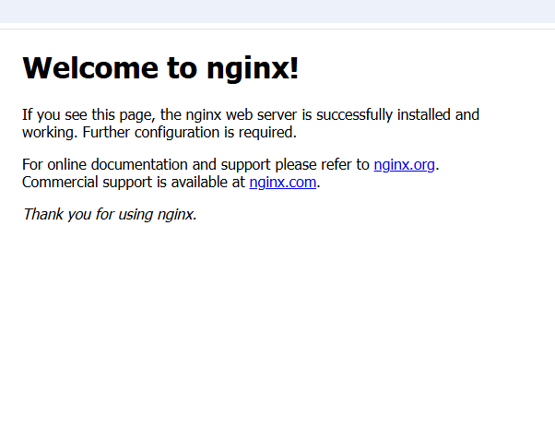
work
docker start <container id>
docker run -p 40:80 -d nginx
Copy Public IPv4 address: port number

Slide 10
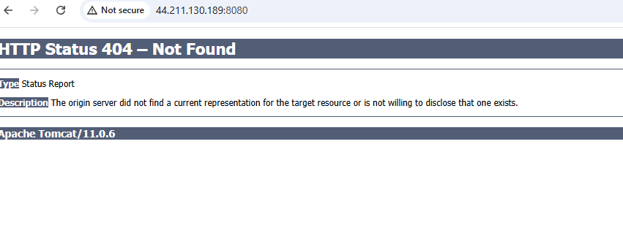
Tomcat

Slide 11
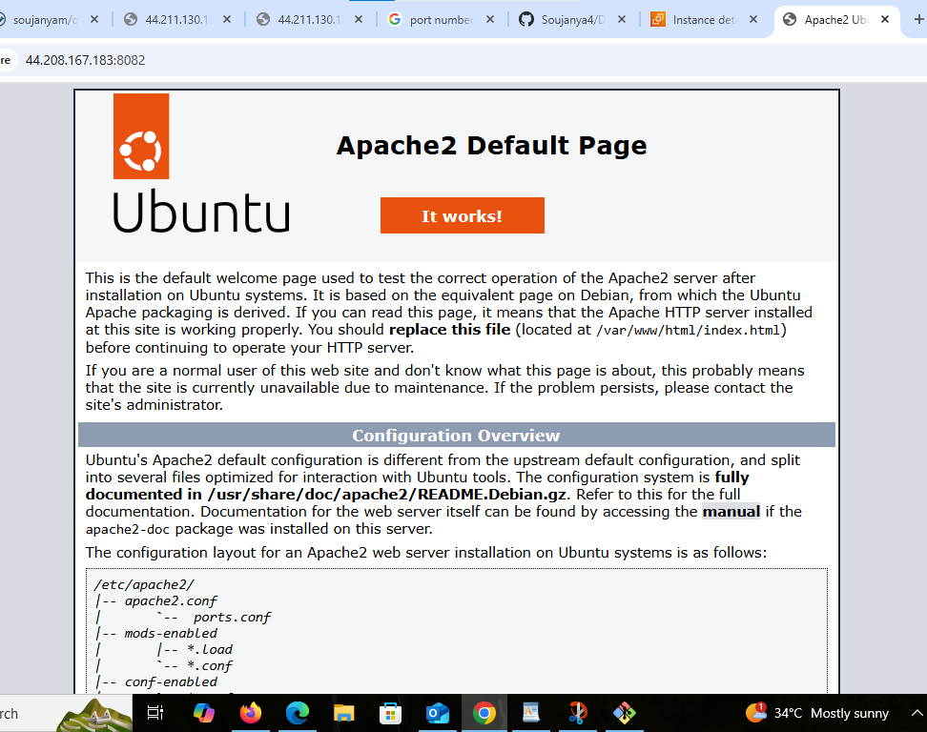
Output of
ubuntu

Slide 12
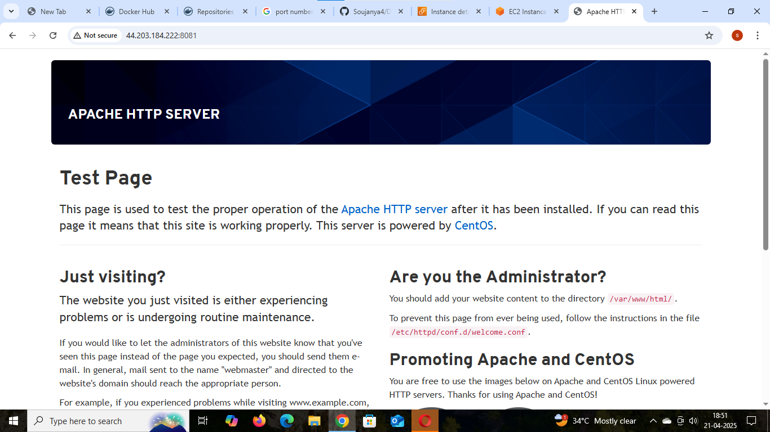
Output of
Centos:

Slide 13
Thank you
soujanya

